Slide 1

CHAPTER 8 Cloud IoT and Maps Services
|LEARNING MICROSOFT AZURE

Slide 2
IOT – The INTERNET OF THINGS
The Fourth Industrial Revolution (Industry 4.0)
Quote: "IoT technologies are a great enabler for Industry 4.0."
Focus: Solutions and services for big data, analytics, and reporting in Azure
Application: Metrics and telemetry data from IoT devices
Understanding IoT:
The Internet of Things (IoT) extends Internet connectivity to physical devices and everyday objects.
IoT devices can communicate, interact, and be remotely monitored.
IoT Architecture and Scalability:
Highly scalable event handling for real-time analysis
Supports machine learning at the intelligent edge
Rise of IoT Devices:
Examples: Smart lamps, wearables, temperature sensors
Impact: Enhancing daily life through data and automation

Slide 3
IoT and Society
Applications:
Smart retail and smart city solutions
Systems:
Internet of Vehicles (IoV)
Internet of Buildings (IoB)
Internet of Agriculture (IoA)
Making Sense of IoT Technology:
Sensors, connectivity, data processing, user interface
Workflow: Data collection, transmission, processing, and visualization

Slide 4
Components & Applications
Components of an IoT Solution:
Sensors & IoT devices
Connectivity methods
Data processing capabilities
User interfaces for visualization
Applications of IoT Solutions:
Smart thermostat systems
Activity trackers
Connected cars
Smart plugs
Smart home systems

Slide 5
Challenges of IoT
Opportunities: Automation, real-time data usage, customer engagement
Advantages:
Technology innovation
Reduced waste
Real-time decision making
Disadvantages of IoT:
Security risks
Privacy issues
Complexity in design and compliance challenges
Common Pitfalls in IoT Projects:
Statistics: Nearly 75% of IoT projects fail
Reasons:
Lack of strategic planning
Technical expertise deficits

Slide 6
Azure IoT Platform
What is Azure IoT?
Azure IoT is a collection of managed service platforms for cloud and edge computing.
Enables users to connect, monitor, and manage billions of IoT devices globally.
Built with features focusing on security, performance, data management, and analytics.
Features:
Customizable solutions based on business needs
Integration with Azure services for scalability and security
Key Components of Azure IoT
Things: Physical devices (e.g., sensors in industrial equipment)
Insights: Data collected by IoT devices, processed and analyzed for actionable knowledge
Actions: User responses to insights that drive business operations

Slide 7
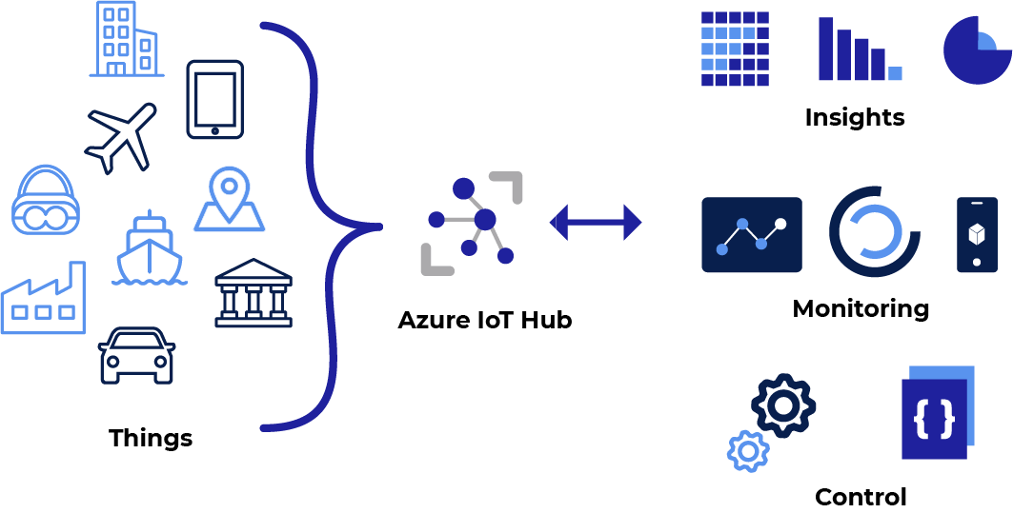
Azure IoT Hub
Central hub for managing communication between IoT devices and applications.
Facilitates data collection like temperature and humidity in real time.
Key Features:
Device provisioning
Telemetry data management
Integration with event-driven and serverless solutions

Slide 8
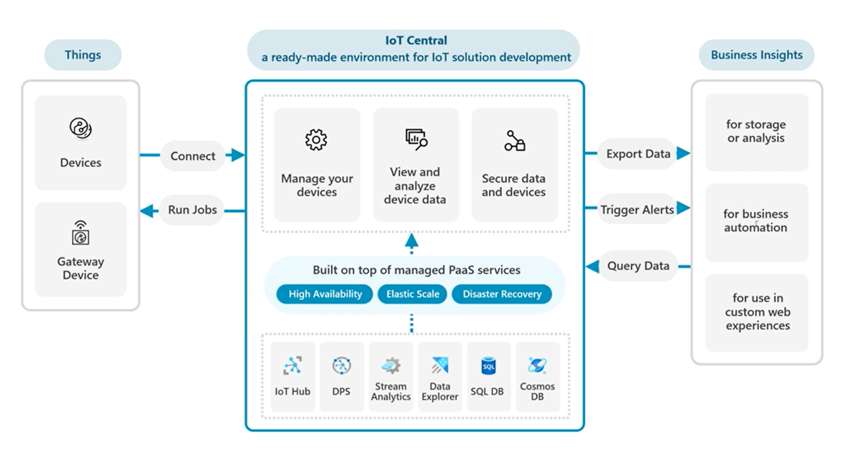
Azure IoT Central
Secure IoT application platform that scales with business needs.
Simplifies IoT solution development and management at the enterprise level.
Key Functions:
Device provisioning and visualization
Telemetry monitoring and integration with other services

Slide 9
Azure IoT Plug and Play
Connect virtually any IoT device using a mobile app.
Ideal for exploring IoT features without investing heavily in dedicated devices.
Benefits:
Telemetry data collection from smartphone sensors
Cloud-based command execution

Slide 10
Azure IoT DevKit
All-in-one development kit for creating IoT prototypes.
Compatible with Arduino and includes various sensors.
Features:
OLED display, hardware debugging, and security chip
Sample IoT projects and documentation

Slide 11
Digital Twins
Platform to create a digital representation of real-world entities.
Provides insights for better product delivery and operational optimization.
Use Cases:
Modeling buildings, factories, energy networks, etc.
Gaining insights for improved customer experiences
Image: Diagram illustrating digital twin architecture

Slide 12
IOT SECURITY
Securing IoT with Defender for IoT
Automatic discovery of unsecured assets and vulnerability detection.
Integration with Azure IoT Hub for enhanced security management.
Key Features:
Threat detection
Security posture management.
Real-time anomaly insights.
Network Analyzers in IoT Security
Role of network analyzers in monitoring traffic and detecting malicious behavior.
Assessing performance and optimizing IoT networks.
Benefits:
Identifying security threats.
Improving data transmission reliability.
Enhancing overall network resilience.

Slide 13
Azure Maps
Overview:
Collection of cloud-based mapping services.
Geospatial assistance for web and mobile applications.
SDKs for mapping data and geographic features.
Key Features of Azure Maps:
Geospatial Services: REST APIs for geocoding, routing, traffic data.
Interactive Maps: Web-based control for adding maps to applications.
Location APIs: Access to points of interest and geofencing data.
Advanced Features:
Spatial Operations: APIs for geofencing, buffering, spatial analysis.
Real-time Traffic: Access to incidents, congestion, traffic flow data.
Mobility Services: Public transit and electric vehicle charging locations.

Slide 14
Compliance and SECURITY
Compliance and Data Residency
Geographic Scope: Specify geographic area for compliance.
Data Residency: All requests stored in the specified region (EU/US).
High Availability: Data replication within geographic locations.
Authentication and Security
Authentication Mechanisms: Microsoft Entra ID, API Key, OAuth 2.0.
Security Features: TLS/SSL encryption, Network Security Groups (NSGs), Role-based Access Control (RBAC).

Slide 15
Getting Started with Azure Maps
Free Account:
Available to help developers begin.
SDKs:
Web and mobile development tools for integration.
Global Availability:
Services available in most countries/regions.
Integrations with Azure Event Grid
Event Handling: Integration with Event Grid for notifications.
Webhook Capabilities: Subscribe to events and trigger actions in real-time.

Slide 16
Development with Azure Maps
REST APIs:
Use Web SDK for Maps Search service.
Search Features:
Address geocoding, fuzzy search, reverse geocoding.
SDKs for Development
Web SDKs:
JavaScript library for web applications.
Mobile SDKs:
iOS and Android SDKs for mobile applications.
Integration:
Easy to add mapping functionality across platforms.

